Slide 1



UNIVERSAL INTERACTION AND TRANSLATION SYSTEM
A PRESENTATION BY
SOWMIYA K
230282601115
UNDER THE GUIDANCE OF
Mrs. T.PANDIYAVATHI
ASSISTANT PROFESSOR(Sr.Gr)
MASTER OF COMPUTER APPLICATIONS (2023-2025)
DEPARTMENT OF COMPUTER APPLICATIONS

Slide 2


PRESENTATION AT A GLANCE
Introduction
Objective
Abstract
Literature Survey
Existing System
Limitations of Existing System
Problem identified
Proposed System
Architecture Diagram
Detailed Algorithm
Code Implementation
Code Implementation- Result
Conclusion
Future Scope
Reference
Course Certificate
Conference Certificate
DEPARTMENT OF COMPUTER APPLICATIONS

Slide 3
INTRODUCTION
This project is designed to support people with disabilities using smart and accessible technology.
It brings together multiple assistive tools into one system to help users with different types of disabilities.
It helps users communicate more effectively and access important information.
The system uses smart technologies like real-time feedback, image processing, and machine learning for better interaction.
The main goal is to make communication and daily activities easier for all users, regardless of their physical challenges.
DEPARTMENT OF COMPUTER APPLICATIONS

Slide 4
OBJECTIVE
The primary objective of this project is to build a smart system that helps people with disabilities communicate better and access information easily.
It combines different helpful tools into one simple and easy-to-use platform.
The system works in real-time and gives quick, accurate responses to support users in daily life.
It is made to include everyone, no matter their physical ability, and improve their quality of life.
The design is also cost-effective and can be used by many people in different places.
DEPARTMENT OF COMPUTER APPLICATIONS

Slide 5
ABSTRACT
The project aims to create a Graphic User Interface (GUI) system that enhances accessibility for individuals with disabilities.
It helps everyone feel included and supports users in becoming more independent.
It combines various tools into one system to help with understanding text, speech, gestures, and colors.
It includes multiple modules like Braille translation, Sign language recognition, Speech training, and Color detection.
It is user-friendly, affordable, and useful in homes, schools, and public spaces for better accessibility.
DEPARTMENT OF COMPUTER APPLICATIONS

Slide 6
LITERTURE SURVEY
TITLE | YEAR OF PUBLICATION | AUTHOR | PUBLISHED | DESCRIPTIONS
Gesture-to-Text: A Real-Time Indian Sign Langua e Translator with Pose Estimation and LSTM | 2024 | Shubham Shetty , Ebrahim Hirani, Abhir Singh, Reeta Koshy | Published By Science Direct | A real-time Indian Sign Language translator using PoseNet for keypoint detection and LSTMs for gesture recognition. It achieves 98% accuracy, enabling seamless gesture-to-text conversion.
A deep learning-based framework for converting multilingual braille images | 2024 | Abdulmalik Al-Salman, Amani AlSalman | Published By Science Direct | framework uses deep learning (LeNet-5) and Mayfly optimization to convert braille images into multilingual text, achieving up to 99.80% accuracy.
DEPARTMENT OF COMPUTER APPLICATIONS

Slide 7
LITERTURE SURVEY
TITLE | YEAR OF PUBLICATION | AUTHOR | PUBLISHED | DESCRIPTIONS
Innovation Design: The Text to Braille-Based Technology in Computer Vision | 2023 | Adi Pratama Putra , Muhamad Khoirul Anam , Muhammad Zainal Roisul Amin , Rezki Nalandari , Adi Mulyadi , Harwanti Noviandari | Journal of Engineering Design And Technology | Text-to-Braille technology uses computer vision and OCR to convert text into tactile Braille output, enabling accessible communication for visually impaired individuals.
Image Pre-Processing Effect on OCR’s Performance for Image Conversion to Braille Unicode | 2023 | Andrean Ignasiusa, Joerio Christo Chandraa, Roberto Oscadinataa, Derwin Suhartonoa | Published By Science Direct | Converting image text to Braille Unicode and enhancing OCR accuracy with pre-processing techniques.
DEPARTMENT OF COMPUTER APPLICATIONS

Slide 8
EXISTING SYSTEM
Many assistive tools are available, but they usually work separately for different disabilities.
Most systems do not provide real-time support or instant feedback, making them slow and less helpful.
There is limited integration of features like gesture recognition, speech feedback, and text translation.
These systems may not be user-friendly for everyone and can be expensive or hard to access.
DEPARTMENT OF COMPUTER APPLICATIONS

Slide 9
LIMITATIONS OF EXISTING SYSTEM
No real-time communication support.
No Voice Commands or Accessibility Features
Dependence on Internet Connection
No Unified Platform
No Reporting/Analytics
No Voice Commands or Accessibility Features
Can’t Handle Video or GIFs
Sign language tools are often slow or inaccurate.
Braille conversion tools are rarely web-based.
DEPARTMENT OF COMPUTER APPLICATIONS

Slide 10
PROBLEM DEFINITION
People with disabilities have to use many separate tools to help them communicate.
Right now, most tools work alone are hard to use together and often need expensive devices .
We want one easy-to-use system that brings all these tools together and works quickly, smoothly.
There’s no single tool right now that helps with all types of disabilities in one place.
DEPARTMENT OF COMPUTER APPLICATIONS

Slide 11
PROPOSED SYSTEM
All-in-One Platform:
Combines Braille translation, Sign Language recognition, Speech Training, and Color Detection into one system.
Real-Time Feedback:
Provides instant responses for better learning and communication.
Easy to Use:
Features a simple interface with voice and gesture controls.
Supports All Disabilities:
Helps users with vision, hearing, speech, or color-recognition challenges.
Personalized & Trackable:
Settings can be customized, and user progress is monitored over time.
DEPARTMENT OF COMPUTER APPLICATIONS

Slide 12
BENEFITS OF PROPOSED SYSTEM
All-in-one platform for multiple disabilities.
Time and Effort Saving
Makes communication easier between disabled and non-disabled users.
User-friendly design with voice and gesture control
Useful for both personal and professional environments.
Improves self-confidence in users
Real-Time Feedback
DEPARTMENT OF COMPUTER APPLICATIONS

Slide 13
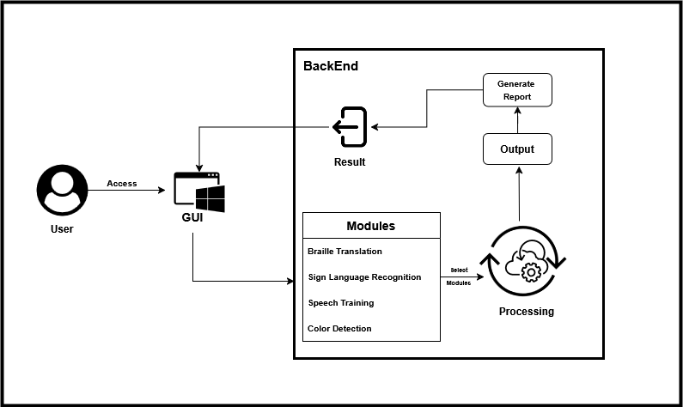
ARCHITECTURE DIAGRAM
DEPARTMENT OF COMPUTER APPLICATIONS

Slide 14
ALGORITHM
Module 1: Braille Translator
Description:
A desktop application built using Python and Tkinter that translates between regular text and Braille. It supports file uploads (TXT, PDF, DOCX), allows users to choose translation direction (Text ↔ Braille), (Braille ↔ Text), and saves the output.
Step:
Upload or Enter Text
Choose Translation Mode
On clicking Translate, the app uses Unicode-based mappings to convert the text accordingly.
Save Output
DEPARTMENT OF COMPUTER APPLICATIONS

Slide 15
ALGORITHM
Module 2: Color Detection
Description:
A desktop application that identifies and reads out the name of a color from either a live webcam feed or a selected image using computer vision and text-to-speech.
Step:
Load GUI & Choose Input Mode
Use Webcam for live detection
Select Image to analyze an existing photo
Capture or Upload Image
Color Detection on Click
Display & Speak the Color Name
DEPARTMENT OF COMPUTER APPLICATIONS

Slide 16
ALGORITHM
Module 3: Speech Training
Description:
The Speech Training System helps users (especially children) practice pronouncing words correctly. It speaks a word, listens to the user, and gives feedback if they said it correctly or not. If the user doesn't get it right, they get more chances to try again.
Step:
Enter Words (e.g: apple, cat, dog)
Listen and Speak
Check and Give Feedback
If the pronunciation is correct You get a "Great job!" message.
If it’s wrong You’ll get another chance to try again.
After max attempts, it moves to the next word.
DEPARTMENT OF COMPUTER APPLICATIONS

Slide 17
ALGORITHM
Module 4: Sign Language
Description:
This desktop application listens to a user’s speech, recognizes spoken words using speech recognition, and then displays the equivalent Indian Sign Language (ISL) in GIF format. If no exact GIF exists, it shows letter-wise images for fingerspelling.
Step:
User Initiates Speech Recognition
Matching ISL GIF
The corresponding sign language GIF is loaded and played
Letter-by-Letter Image Display
Regardless of phrase match, the recognized word is also shown using individual letter images
Save Feature
DEPARTMENT OF COMPUTER APPLICATIONS

Slide 18
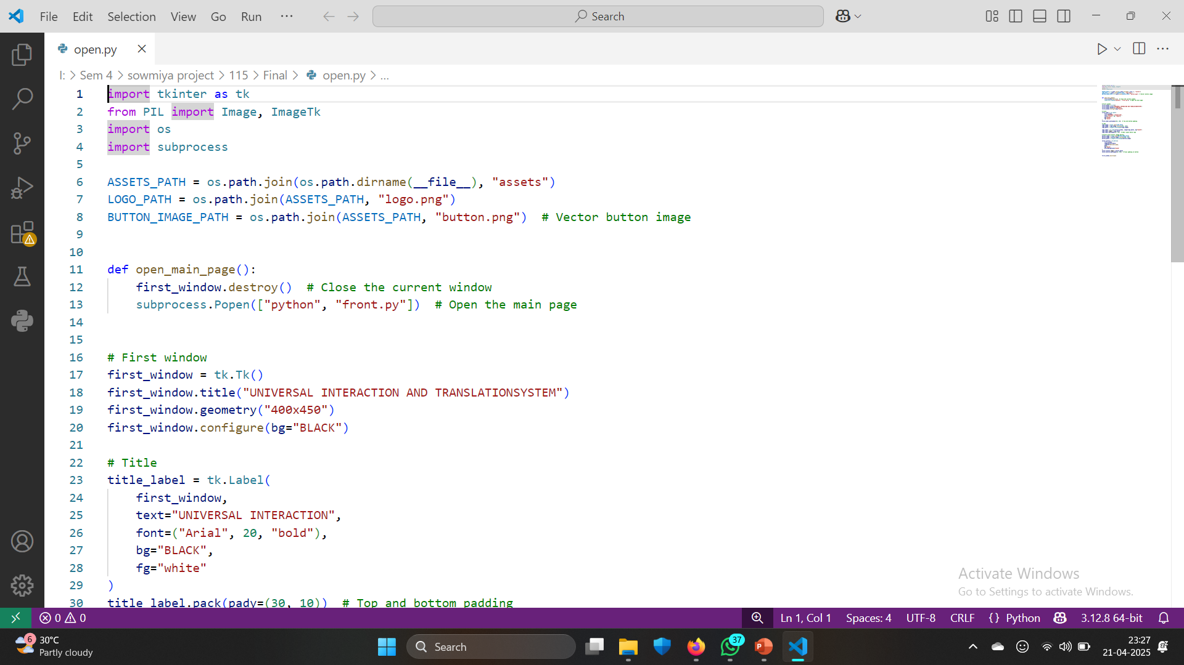
CODE IMPLEMENTATION
Launch Application
DEPARTMENT OF COMPUTER APPLICATIONS

Slide 19
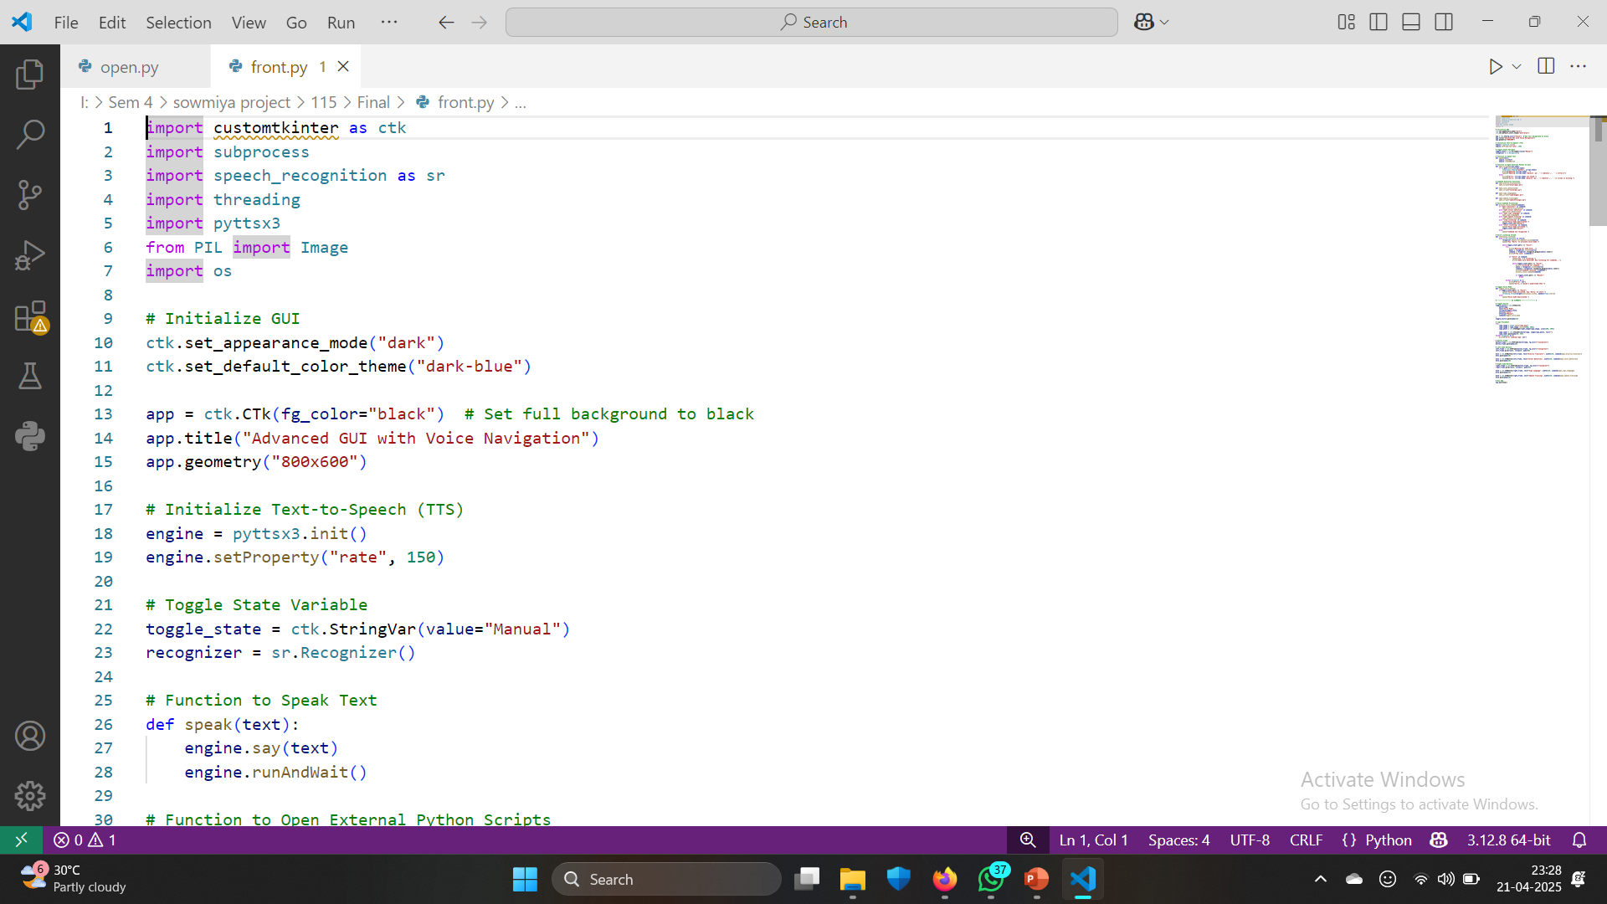
CODE IMPLEMENTATION
Select Modules
DEPARTMENT OF COMPUTER APPLICATIONS

Slide 20
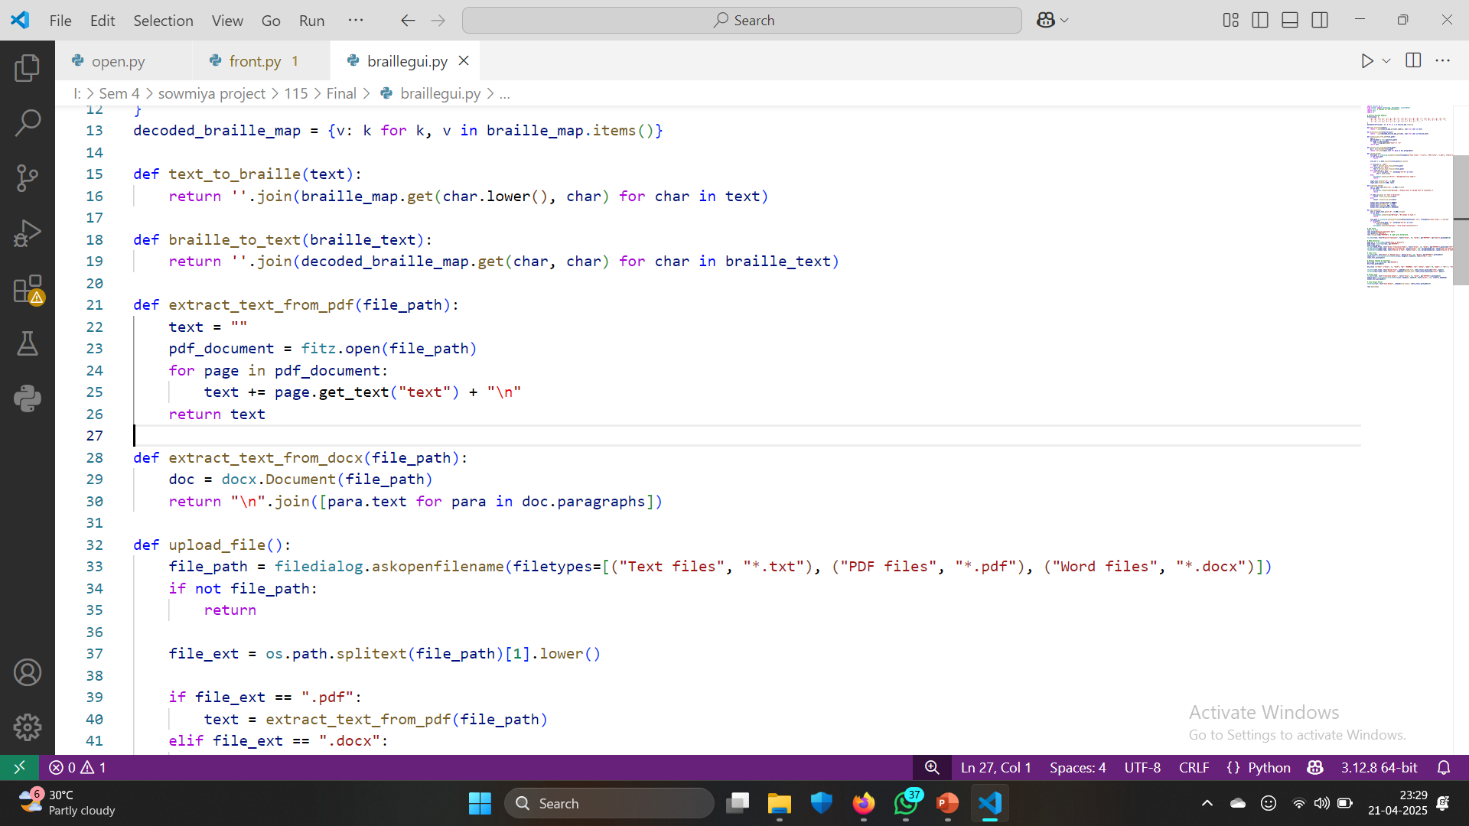
CODE IMPLEMENTATION
Braille Translator GUI
DEPARTMENT OF COMPUTER APPLICATIONS

Slide 21
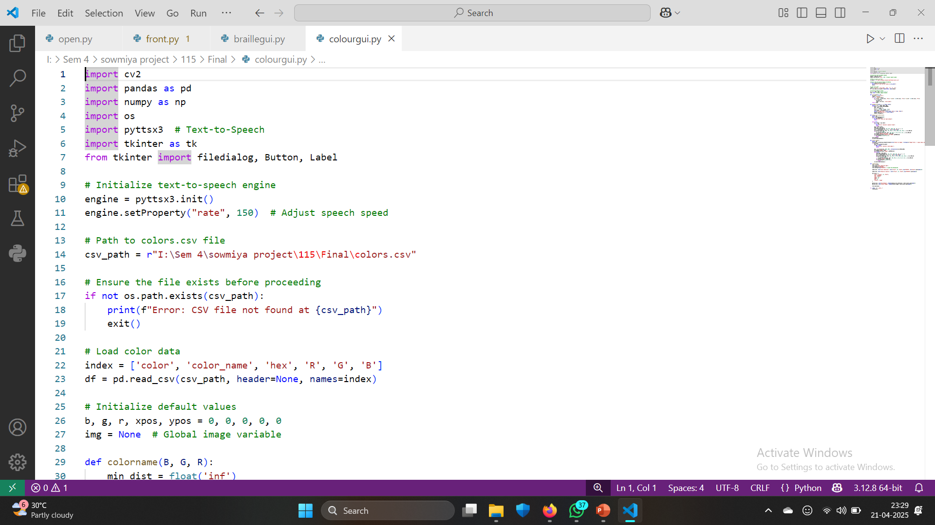
CODE IMPLEMENTATION
Color Detection GUI
DEPARTMENT OF COMPUTER APPLICATIONS

Slide 22
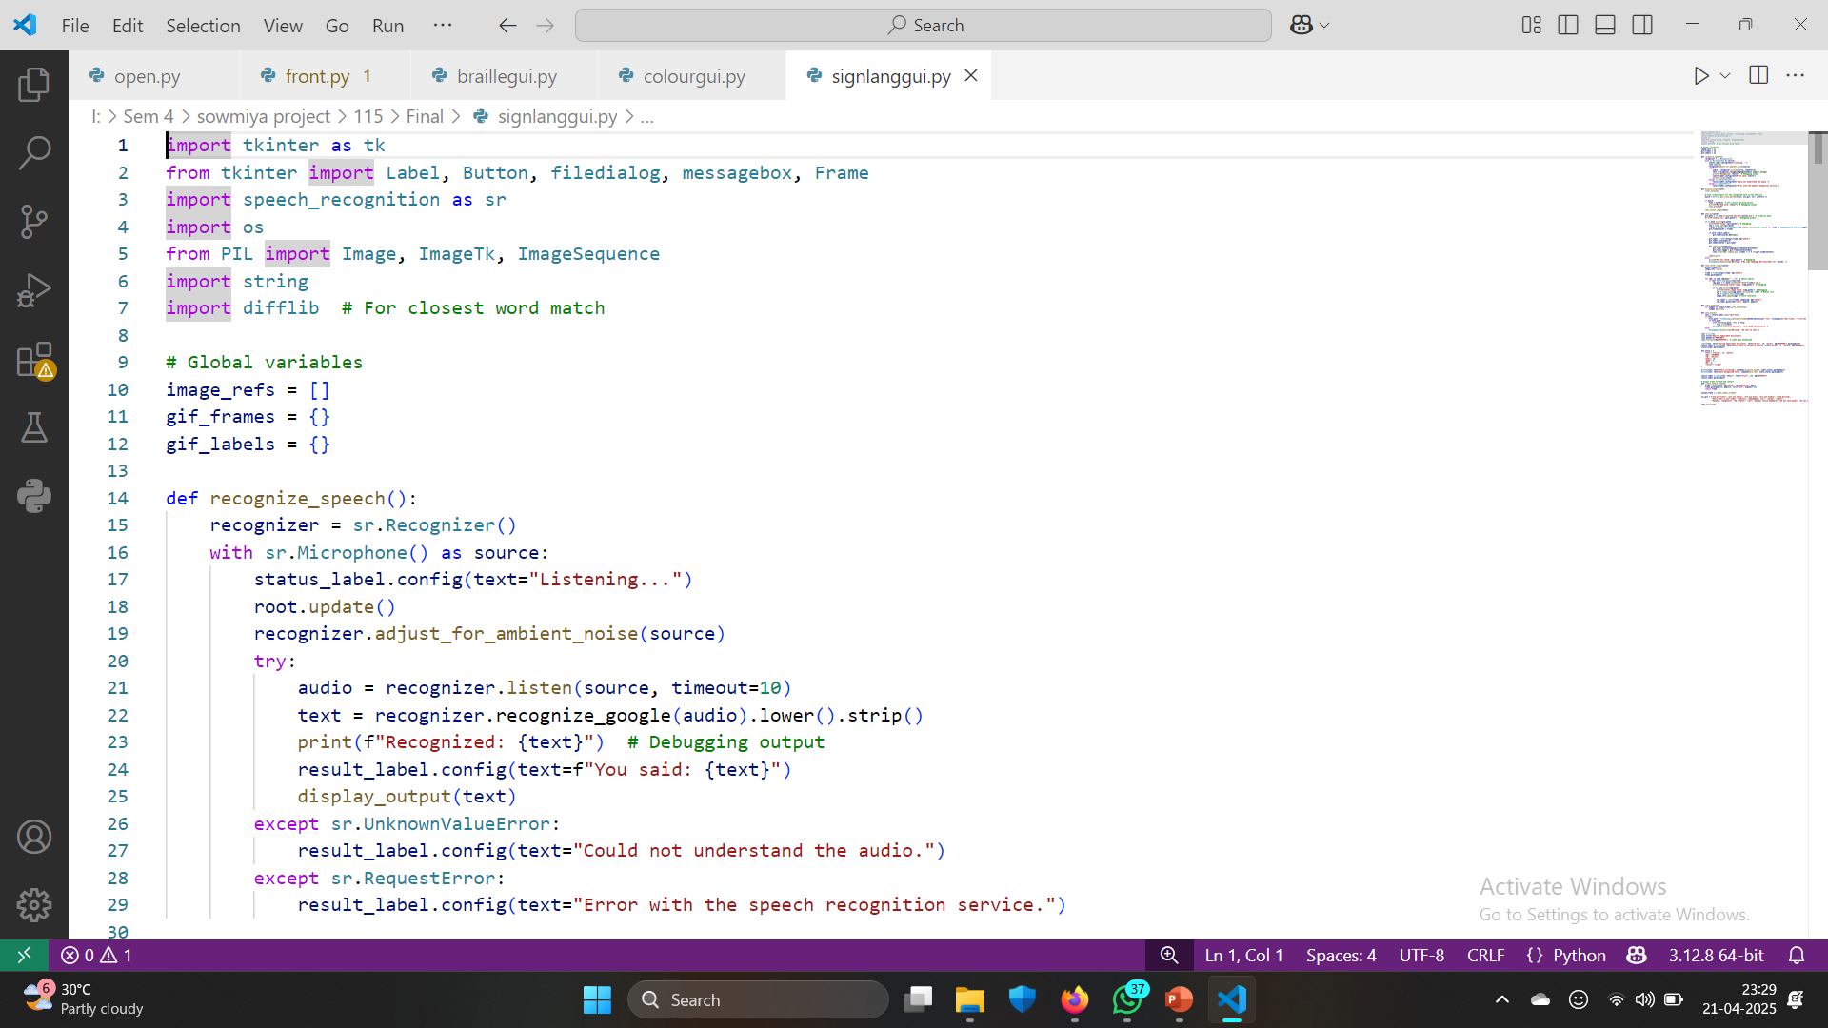
CODE IMPLEMENTATION
Sign Language GUI
DEPARTMENT OF COMPUTER APPLICATIONS

Slide 23
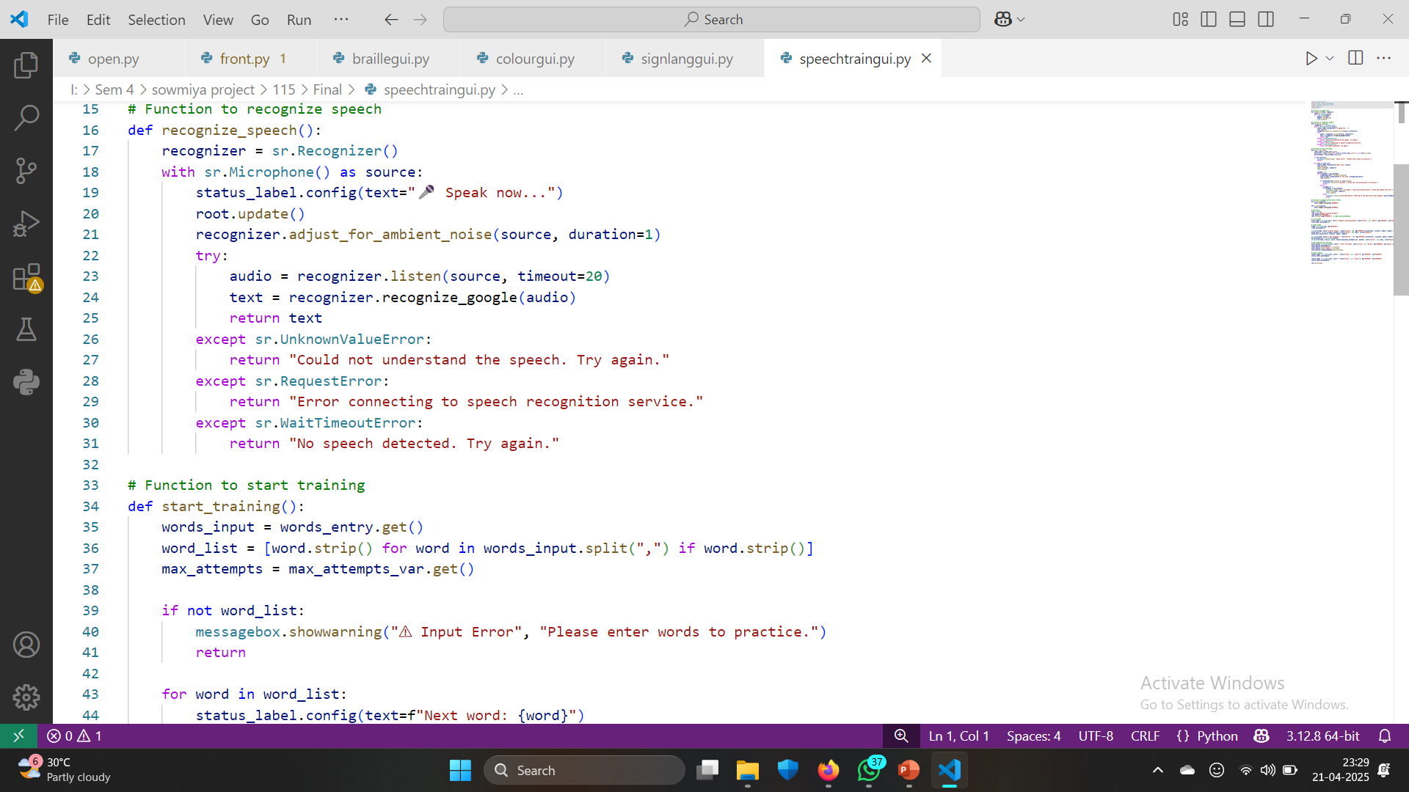
CODE IMPLEMENTATION
Speech Training GUI
DEPARTMENT OF COMPUTER APPLICATIONS

Slide 24
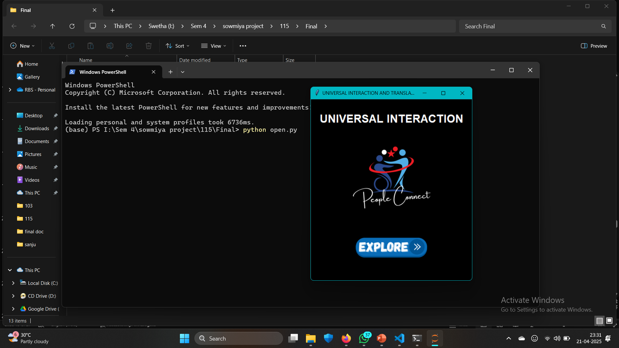
CODE IMPLEMENTATION-RESULT
Launch Application
DEPARTMENT OF COMPUTER APPLICATIONS

Slide 25
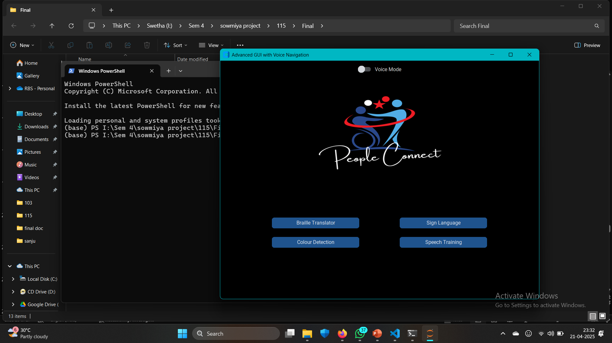
CODE IMPLEMENTATION-RESULT
Select Features
DEPARTMENT OF COMPUTER APPLICATIONS

Slide 26
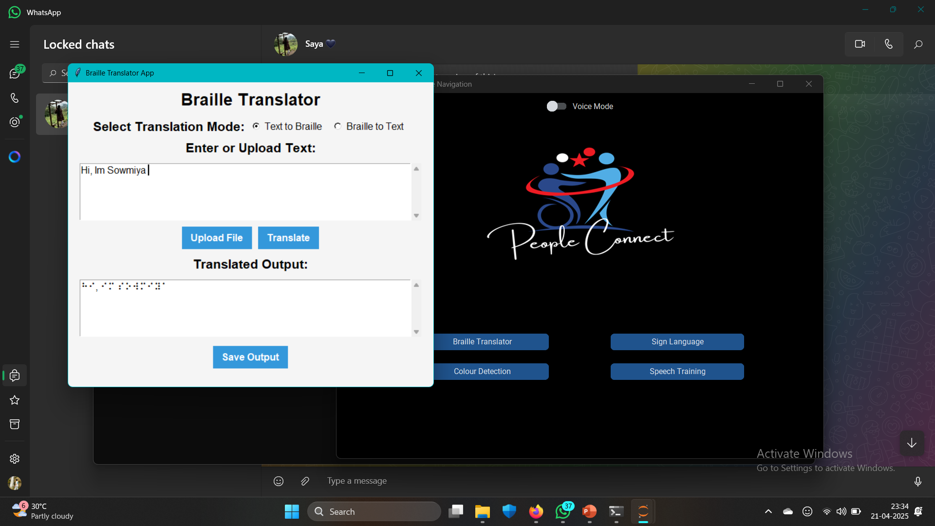
CODE IMPLEMENTATION-RESULT
Text to Braille
DEPARTMENT OF COMPUTER APPLICATIONS

Slide 27
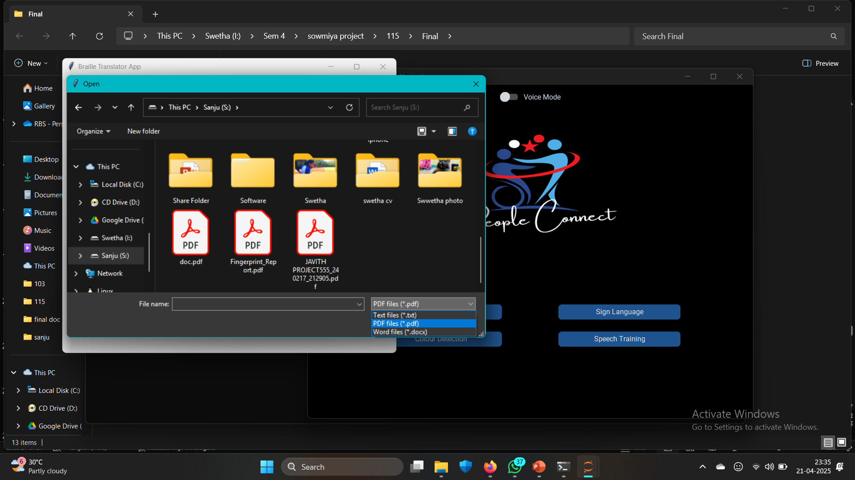
CODE IMPLEMENTATION-RESULT
File to Braille Language
DEPARTMENT OF COMPUTER APPLICATIONS

Slide 28
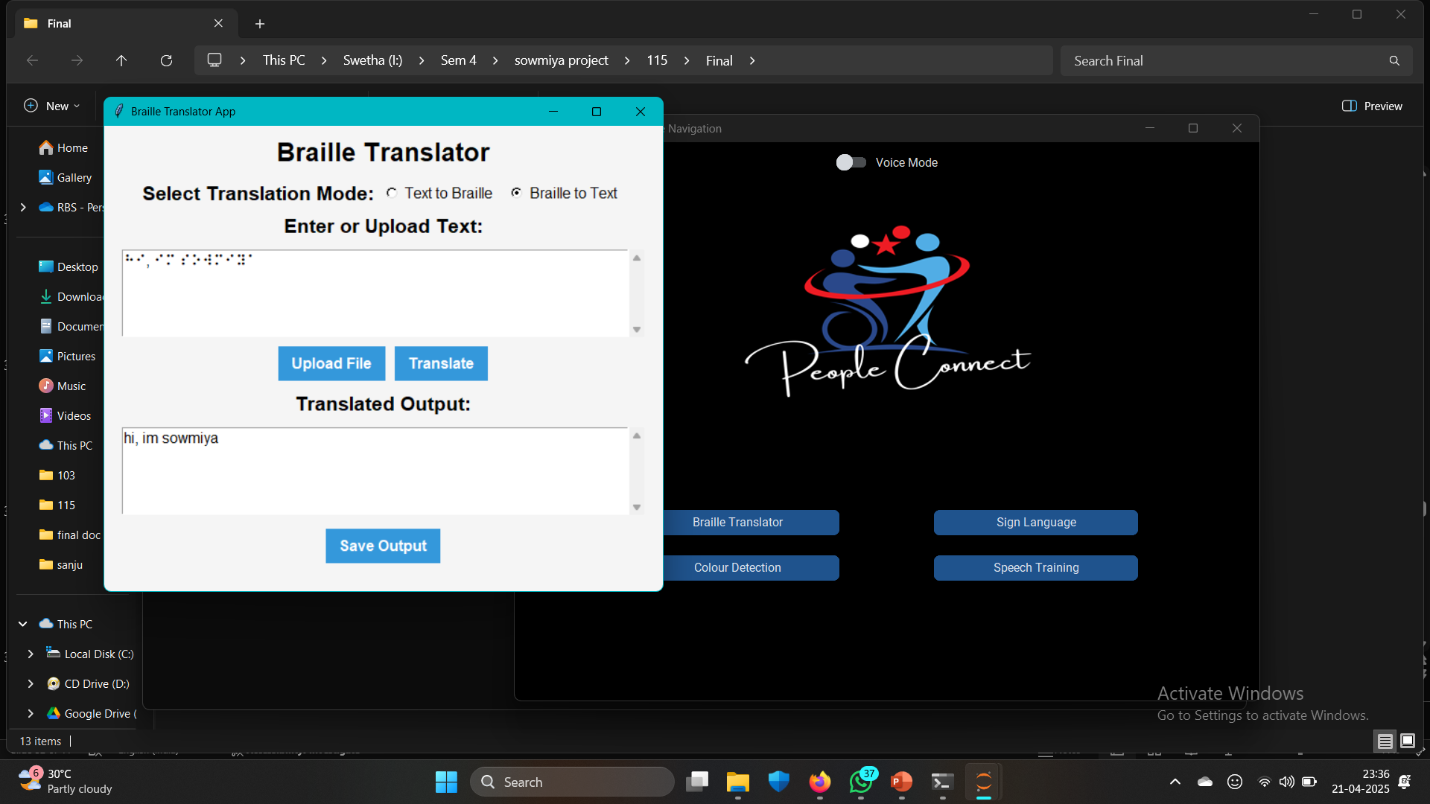
CODE IMPLEMENTATION-RESULT
Braille to Text
DEPARTMENT OF COMPUTER APPLICATIONS

Slide 29
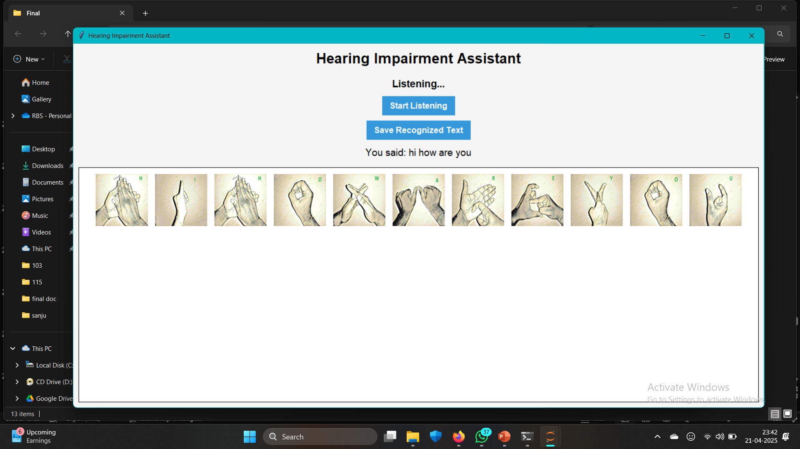
CODE IMPLEMENTATION-RESULT
Sign Language letter
DEPARTMENT OF COMPUTER APPLICATIONS

Slide 30
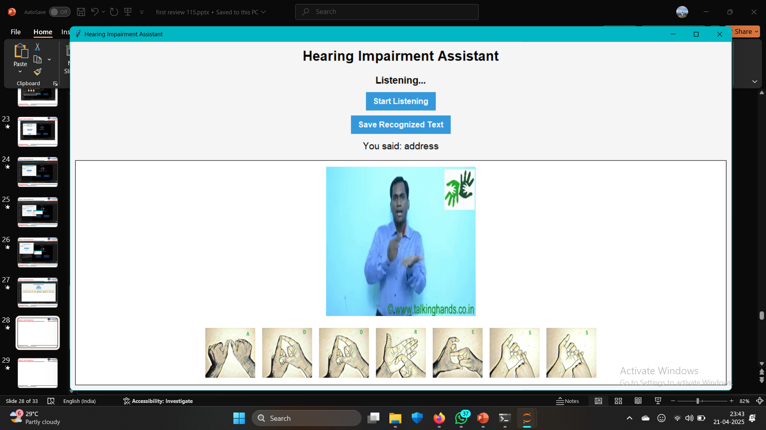
CODE IMPLEMENTATION-RESULT
Sign Language GIF/Letter
DEPARTMENT OF COMPUTER APPLICATIONS

Slide 31
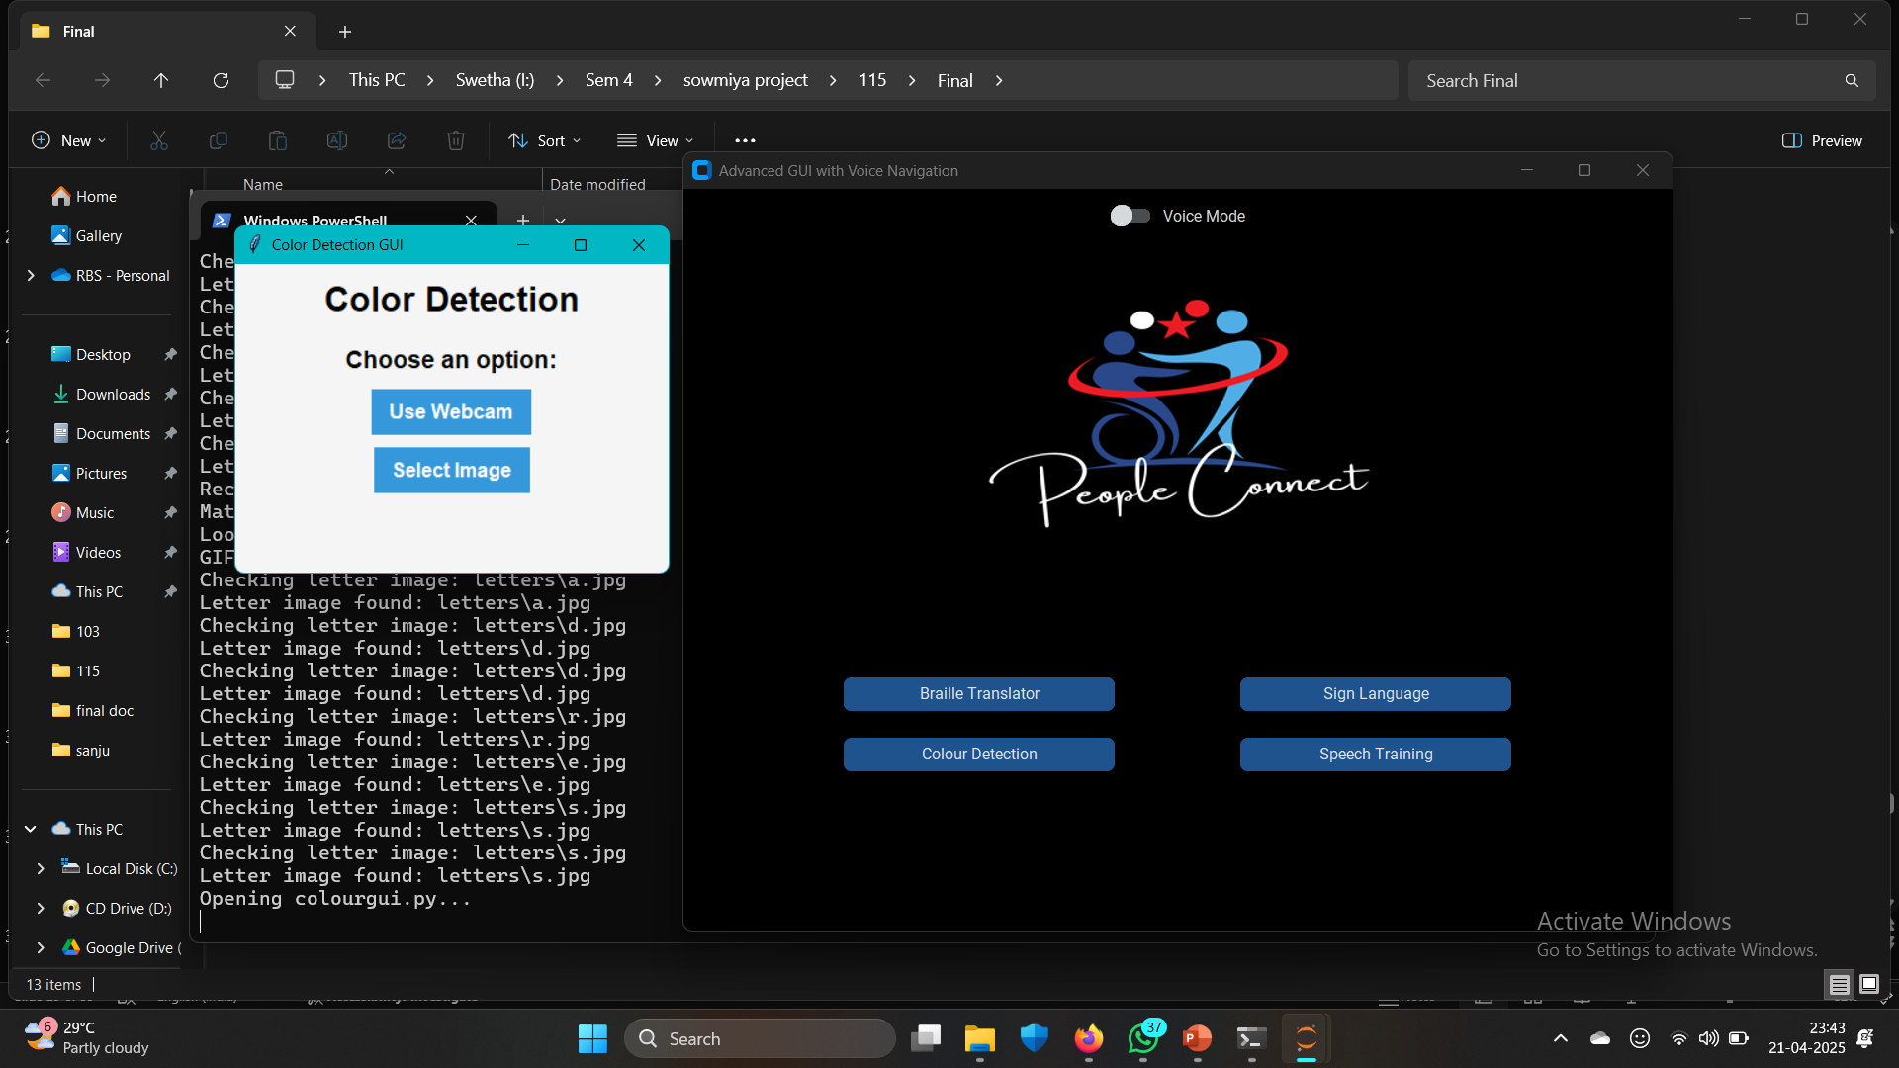
CODE IMPLEMENTATION-RESULT
Color Detection
DEPARTMENT OF COMPUTER APPLICATIONS

Slide 32
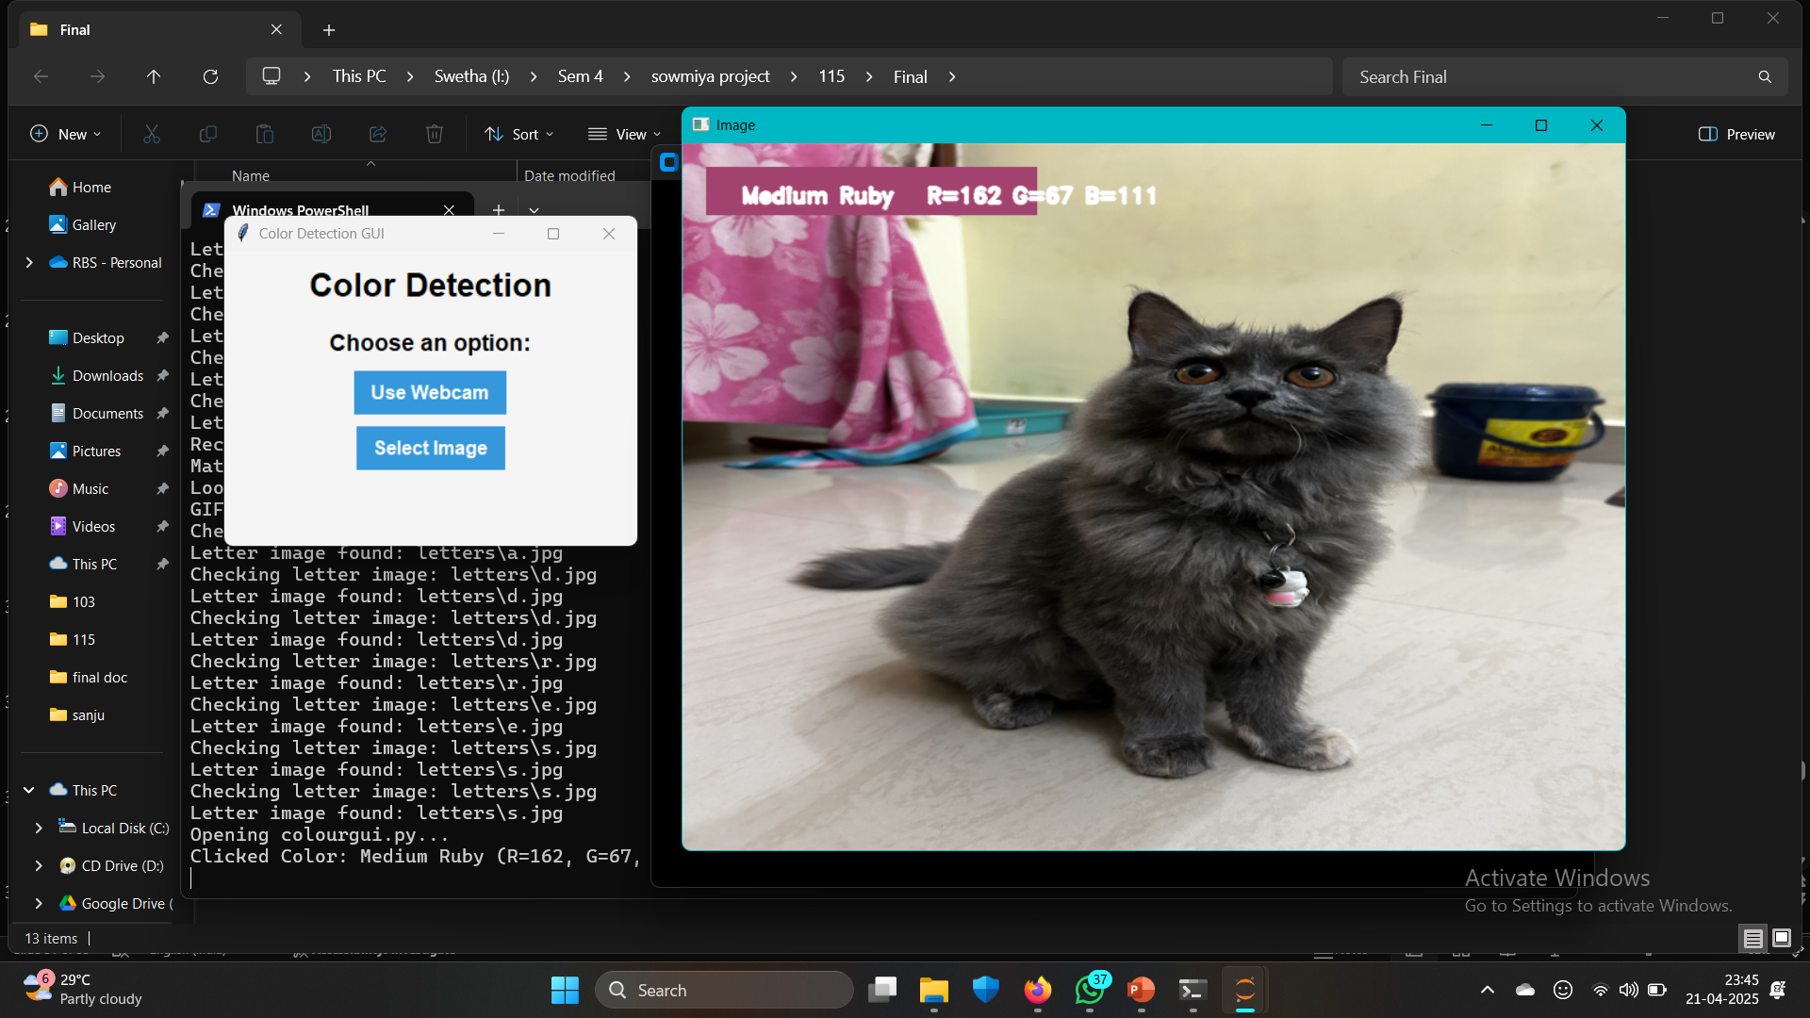
CODE IMPLEMENTATION-RESULT
Image Color Detection
DEPARTMENT OF COMPUTER APPLICATIONS

Slide 33
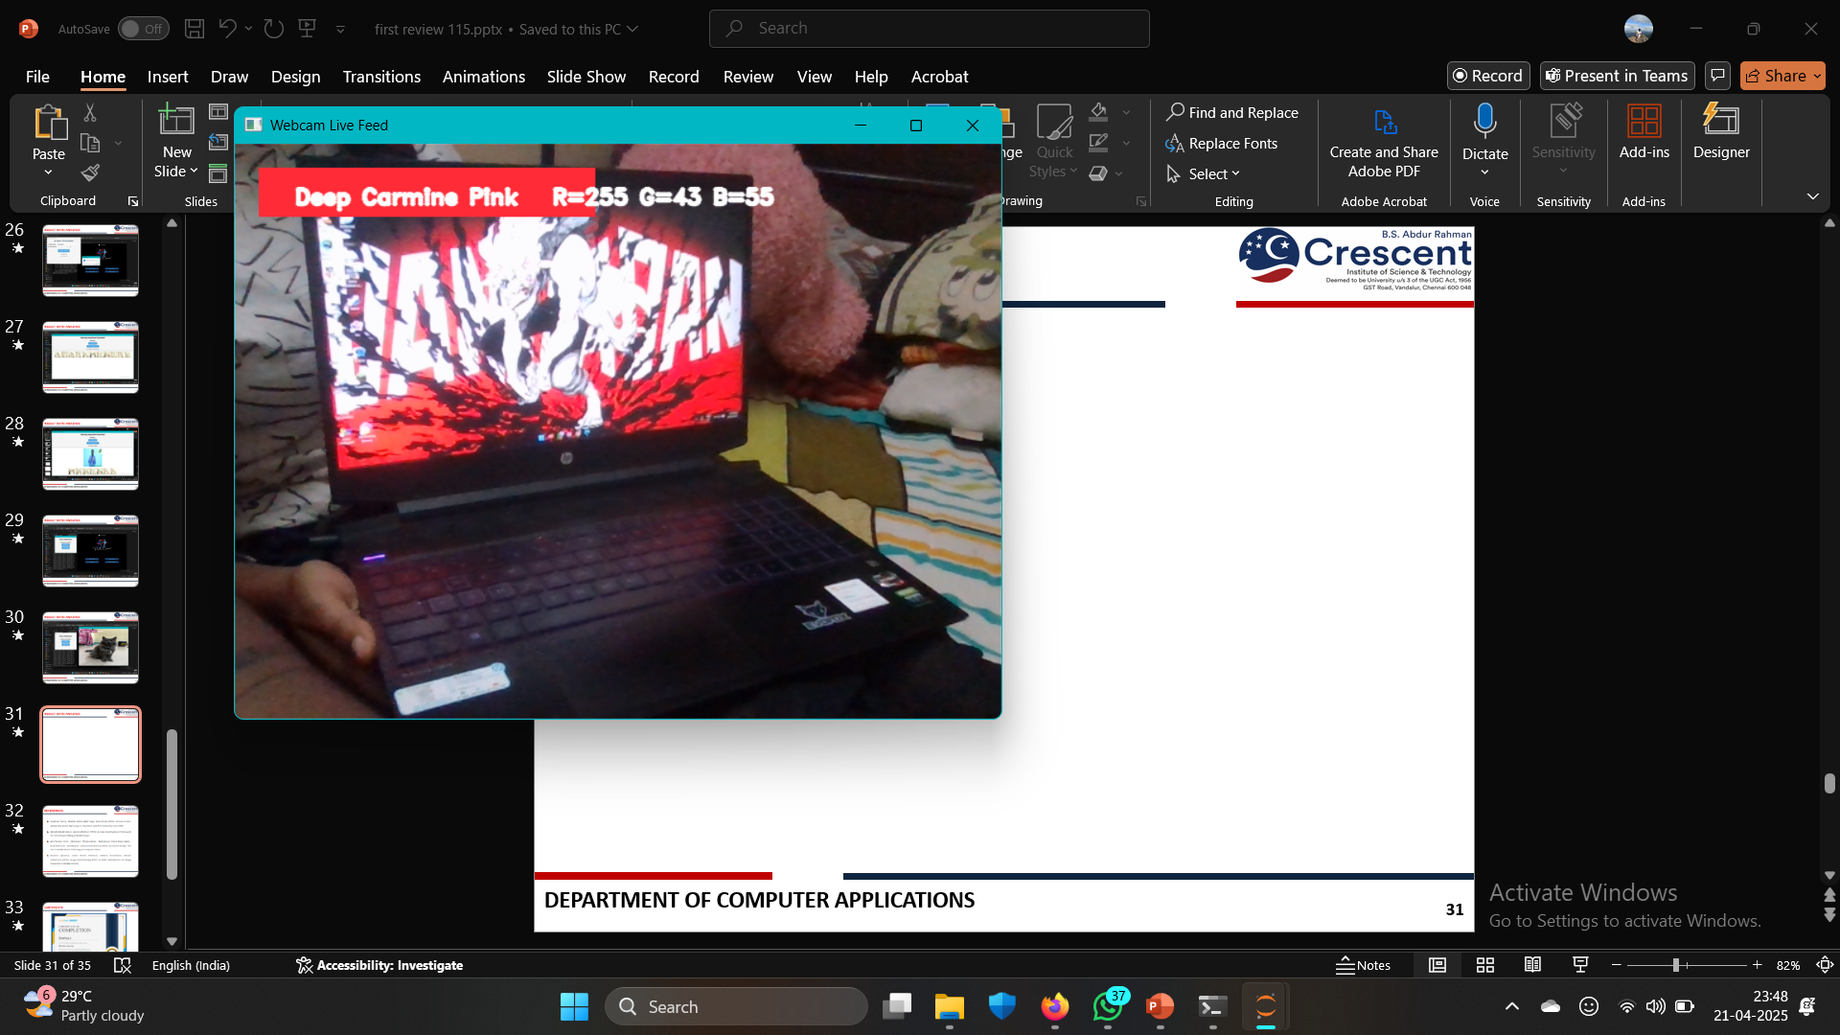
CODE IMPLEMENTATION-RESULT
Live Webcam Color Detection
DEPARTMENT OF COMPUTER APPLICATIONS

Slide 34
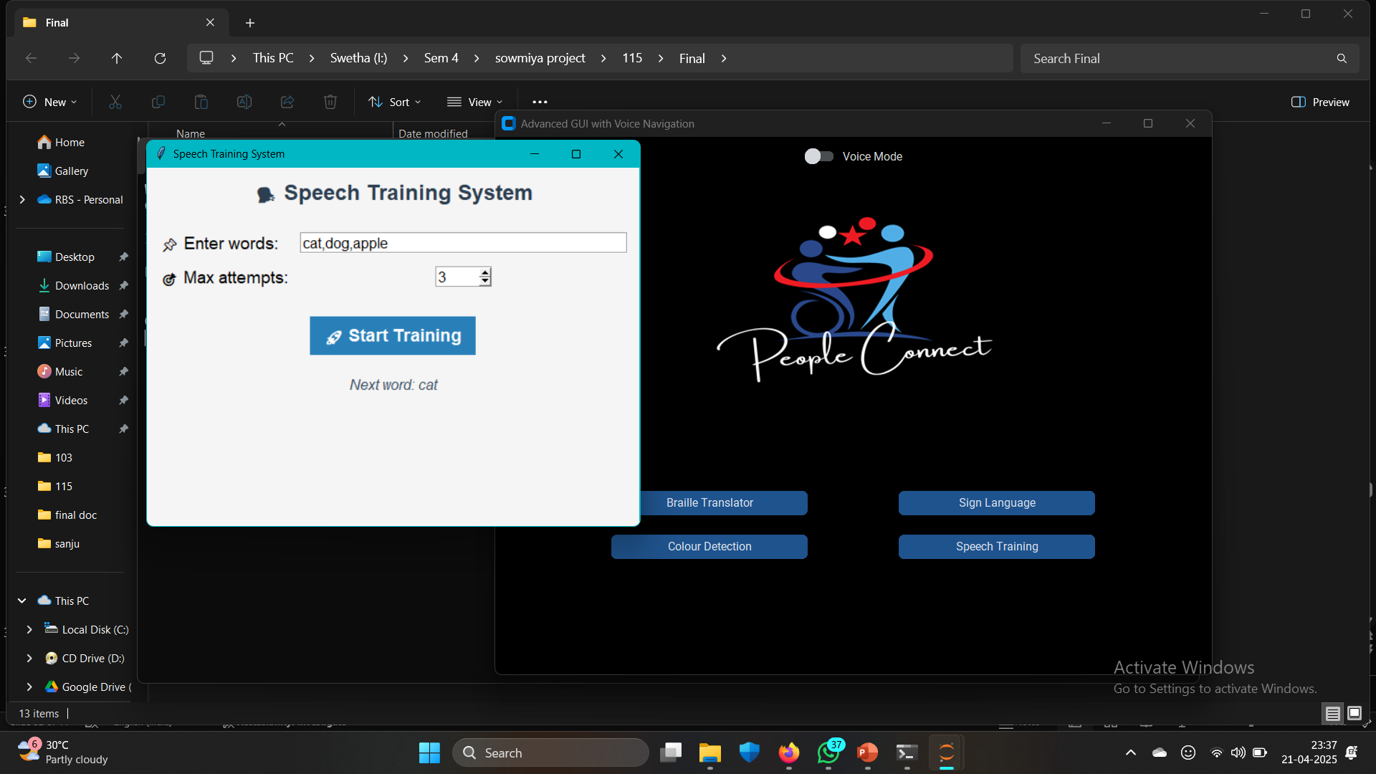
CODE IMPLEMENTATION-RESULT
Speech Training Home Page
DEPARTMENT OF COMPUTER APPLICATIONS

Slide 35
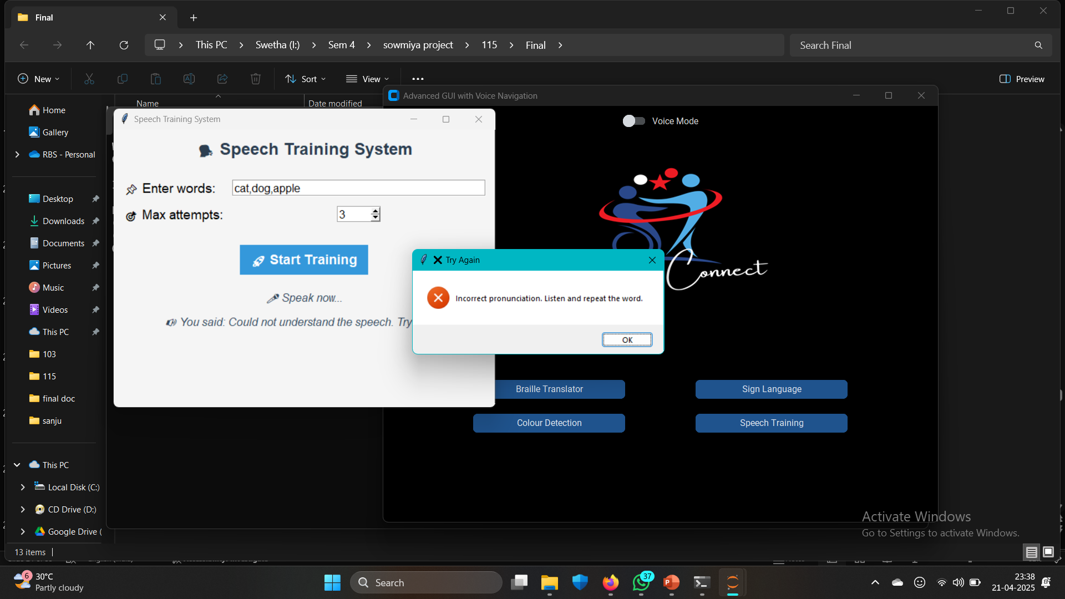
CODE IMPLEMENTATION-RESULT
Wrong Pronunciation
DEPARTMENT OF COMPUTER APPLICATIONS

Slide 36
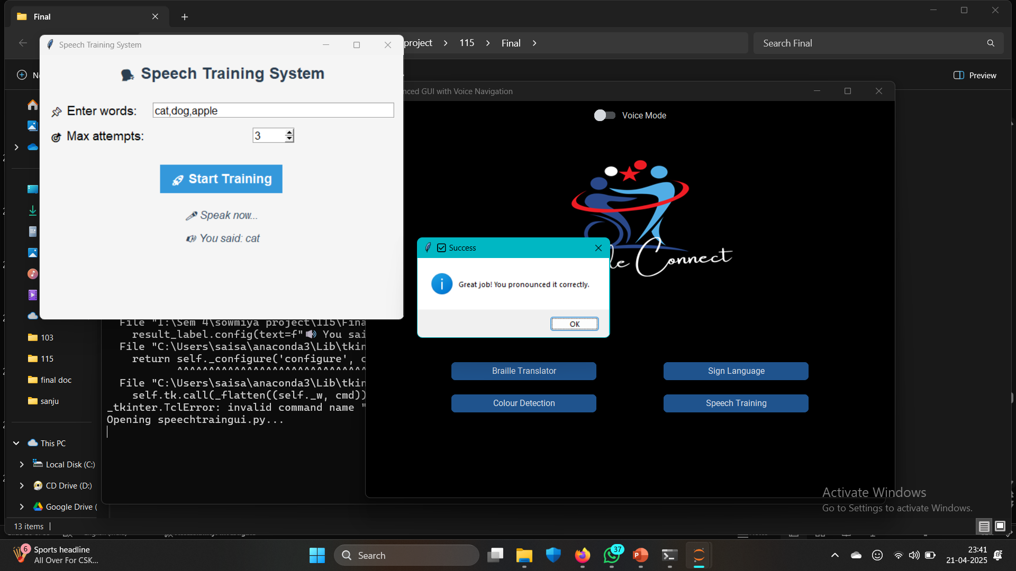
CODE IMPLEMENTATION-RESULT
Correct Pronunciation
DEPARTMENT OF COMPUTER APPLICATIONS

Slide 37
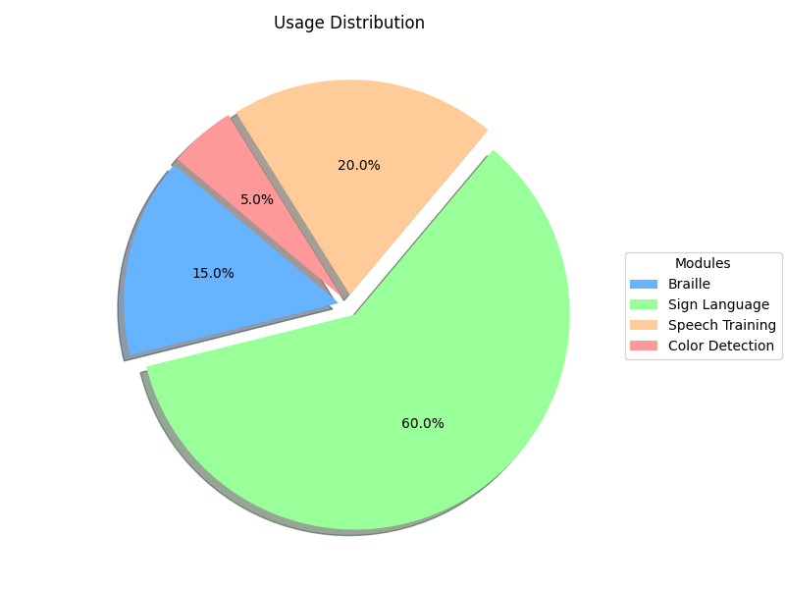
RESULT AND ANALYSIS
Usage Distribution
DEPARTMENT OF COMPUTER APPLICATIONS

Slide 38
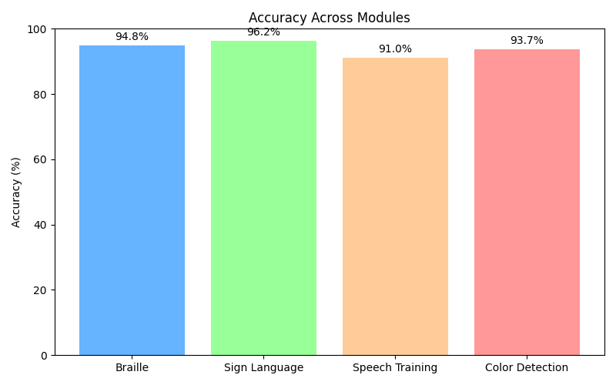
RESULT AND ANALYSIS
Accuracy
DEPARTMENT OF COMPUTER APPLICATIONS

Slide 39
REFERENCES
[1] E. H. A. S. ,. K. Shubham Shetty, “Gesture-to-Text: A Real-Time Indian Sign Language Translator,” ScienceDirect, 2023.
[2] P. K. S. A. A. Nisheeth Joshi, “English to Arabic Braille Neural Machine Translation Through,” ScienceDirect, 2024.
[3] A. A. Abdulmalik Al-Salman, “Fly-LeNet: A deep learning-based framework for converting,” ScienceDirect, 2024.
[4] J. C. C. R. O. D. S. Andrean Ignasius, “Image Pre-Processing Effect on OCR’s Performance for Image Conversion,” ScienceDirect, 2023.
[5] M. K. A. ,. M. Z. R. A. ,. R. N. ,. A. M. ,. H. N. Adi Pratama Putra, “INNOVATION DESIGN THE TEXT TO BRAILLE BASED TECHNOLOGY IN COMPUTER VISION,” Journal of Engineering Design and Technology, 2023.
[6] A. P. M. T. D. P. Ankit Ojha, “Sign Language to Text and Speech Translation in,” International Journal of Engineering Research & Technology (IJERT), 2020.
DEPARTMENT OF COMPUTER APPLICATIONS

Slide 40
REFERENCES
[7] E. H. A. S. R. K. Shubham Shetty, “Gesture-to-Text: A Real-Time Indian Sign Language Translator,” ScienceDirect, 2024.
[8] Smith, J., & Taylor, L. Advances in Real-Time Speech Training Systems for Accessibility. International Journal of Assistive Technologies,2024.
[9] Patel, R., & Kim, S. Speech Recognition and Feedback Systems for Individuals with Disabilities: A Review. Journal of Speech and Language Technology,2024.
[10] Bhattacharya, S., & Weng, Y. (2023). An End-to-End Deep Learning Approach for Speech Therapy Applications. IEEE Access,2023
[11] Nasiri, A., & Sadeghi, S. (2023). Deep Learning-Based Color Detection and Classification for Assistive Technologies. Sensors, 2023
[12] A. Nasiri and S. Sadeghi, "Deep Learning-Based Color Detection and Classification for Assistive Technologies," Sensors,2023
DEPARTMENT OF COMPUTER APPLICATIONS

Slide 41
CONCLUSION
The Universal Interaction and Translation System is an all-in-one assistive technology platform designed to support individuals with visual, hearing, speech, and motor impairments by integrating tools like Braille translation, Sign Language recognition, Speech Training, and Color Detection into a single, user-friendly interface. With features such as real-time feedback, voice and gesture controls, customizable settings, and cloud-based access, the system provides a seamless, adaptable experience that enhances communication, independence, and accessibility. Its scalable design allows for future upgrades, ensuring long-term relevance and continued support for a wide range of user needs.
DEPARTMENT OF COMPUTER APPLICATIONS

Slide 42
FUTURE ENHANCEMENT
In the future, the system can be enhanced through cloud deployment to enable access from any device with internet connectivity, ensuring portability and real-time synchronization. Integration with IoT (Internet of Things) devices can provide users with environmental awareness, like obstacle detection or smart home control, further boosting independence. Support for high-resource modules, such as advanced deep learning models for better sign language and speech recognition, can improve accuracy and performance. Additionally, developing a wearable version of the platform like smart glasses or wristbands can make the system even more accessible and convenient for everyday use.
DEPARTMENT OF COMPUTER APPLICATIONS

Slide 43
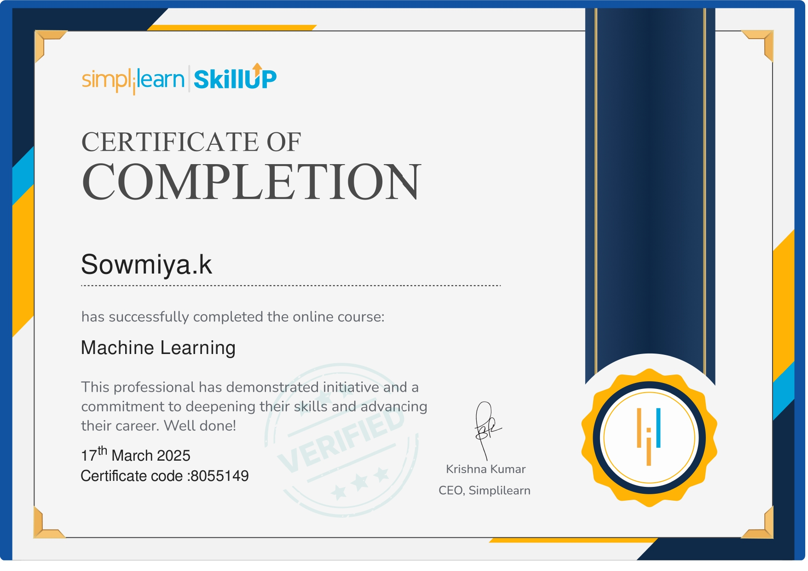
COURSE CERTIFICATE
DEPARTMENT OF COMPUTER APPLICATIONS

Slide 44
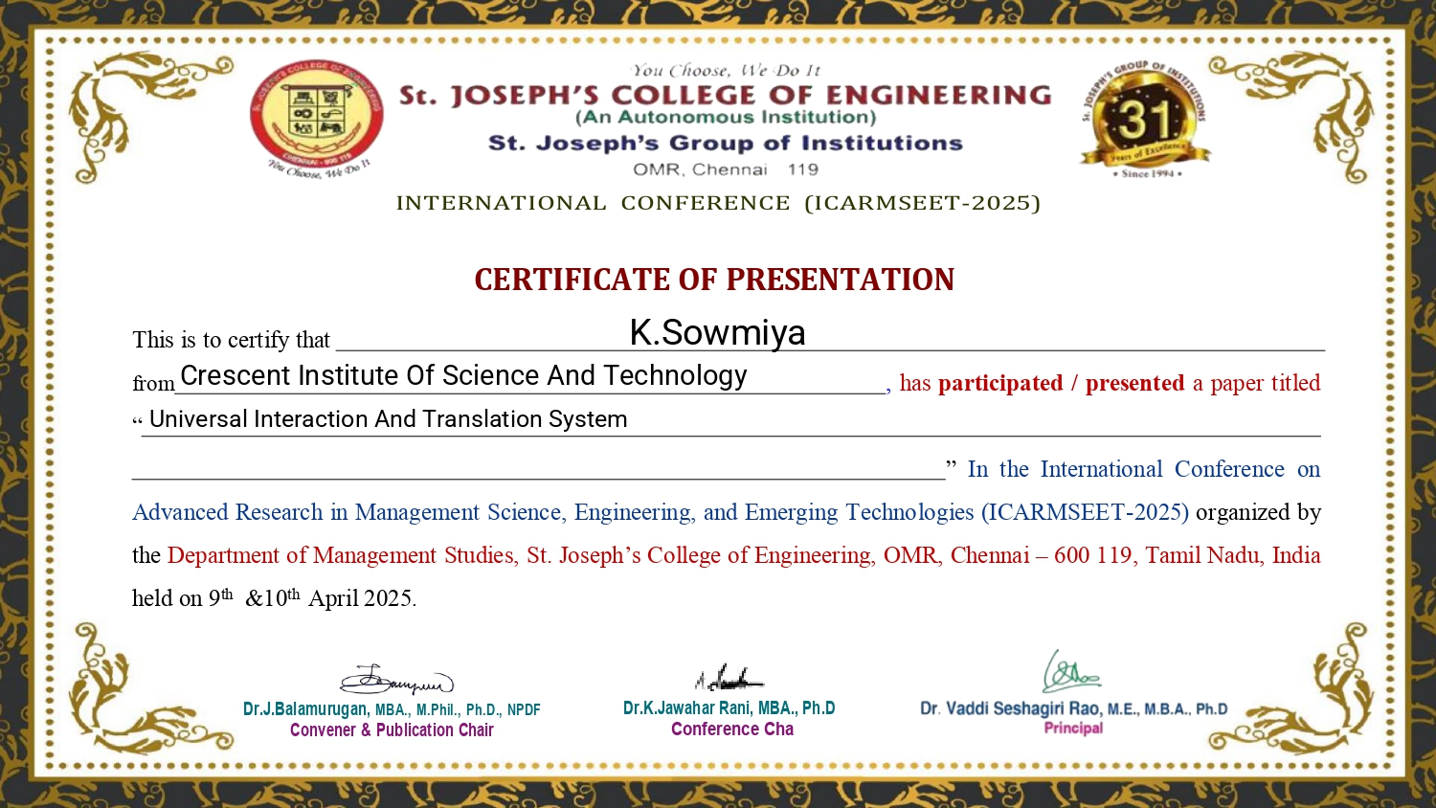
CONFERENCE CERTIFICATE
DEPARTMENT OF COMPUTER APPLICATIONS

Slide 45

DEPARTMENT OF COMPUTER APPLICATIONS

Slide 46
DEPARTMENT OF COMPUTER APPLICATIONS

Slide 47
DEPARTMENT OF COMPUTER APPLICATIONS

Slide 48
DEPARTMENT OF COMPUTER APPLICATIONS

Slide 49
DEPARTMENT OF COMPUTER APPLICATIONS

Slide 50
DEPARTMENT OF COMPUTER APPLICATIONS

Slide 51
DEPARTMENT OF COMPUTER APPLICATIONS

Slide 52
DEPARTMENT OF COMPUTER APPLICATIONS

Slide 53
DEPARTMENT OF COMPUTER APPLICATIONS

Slide 54
DEPARTMENT OF COMPUTER APPLICATIONS

Slide 55
DEPARTMENT OF COMPUTER APPLICATIONS

Slide 56
DEPARTMENT OF COMPUTER APPLICATIONS

Slide 57
DEPARTMENT OF COMPUTER APPLICATIONS

Slide 58
DEPARTMENT OF COMPUTER APPLICATIONS

Slide 59
DEPARTMENT OF COMPUTER APPLICATIONS

Slide 60
DEPARTMENT OF COMPUTER APPLICATIONS

Slide 61
DEPARTMENT OF COMPUTER APPLICATIONS

Slide 62
DEPARTMENT OF COMPUTER APPLICATIONS

Slide 63
DEPARTMENT OF COMPUTER APPLICATIONS

Slide 64
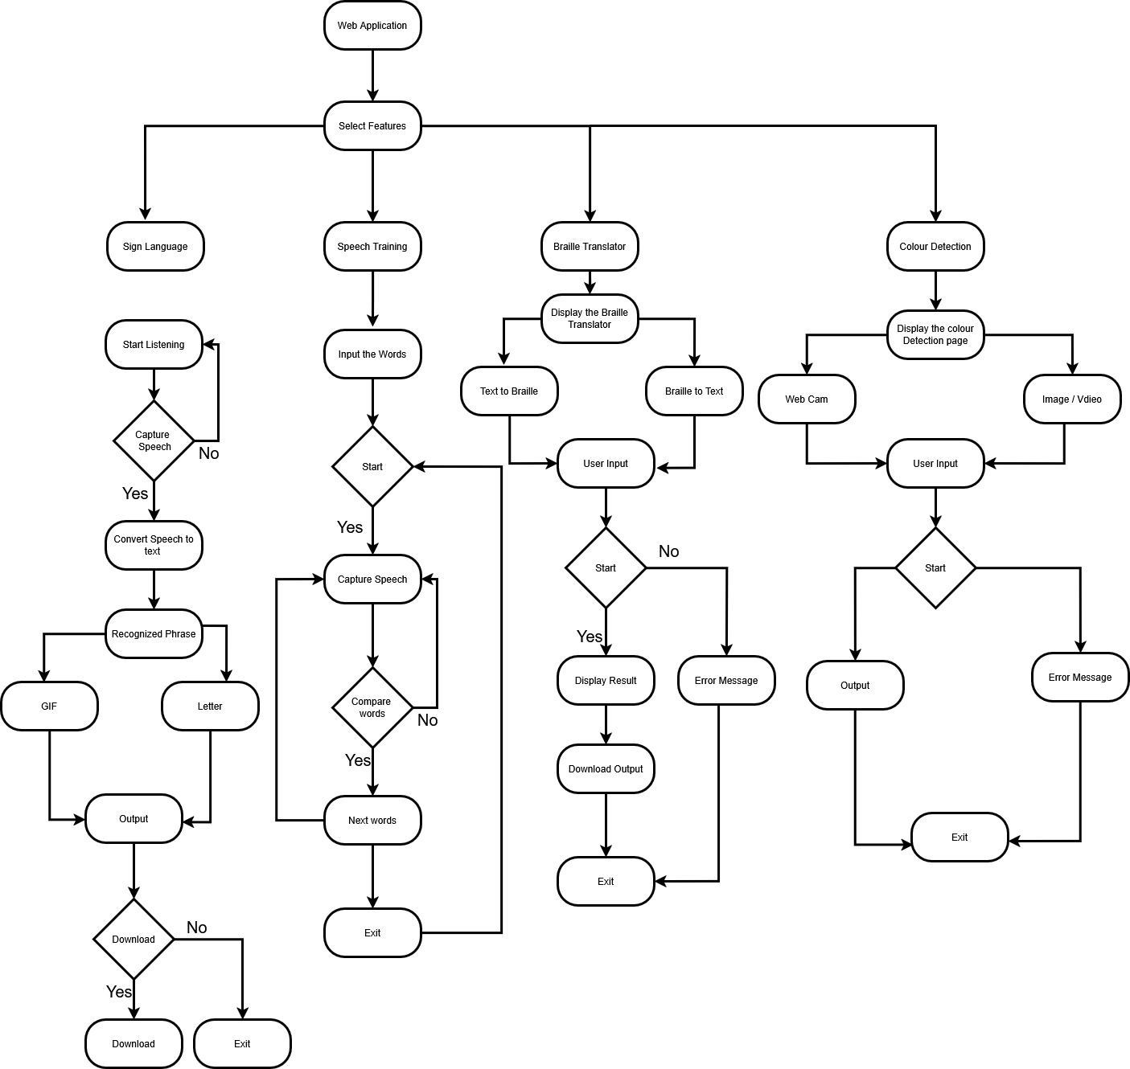
FLOWCHART DIAGRAM
DEPARTMENT OF COMPUTER APPLICATIONS

